Slide 1
Investigating Water
- Where it comes from
- How we use it

Slide 2
Think , Pair, Share
On you own think about the following question:
Where does Australia’s water come from?
When your time is up share your ideas with the person next to you.
Be prepared to share with the class.

Slide 3
Water in Australia
We should already know the main uses of water in our country.
Can you name them?
Water availability is therefore critical to the well being of our society.

Slide 4
Water Cycle
We also know that water is essentially a renewable resource as it is part of a closed system where water is constantly exchanged between the oceans, land and the atmosphere.
Can you remember PERTIC??

Slide 5
Water Availability
However…
The following processes determine how much water is available to us:
How much rain we receive
How quickly it evaporates
How much is transpired by plants
How much runs off land to fill lakes and aquifers

Slide 6
Water Availability
Water is a scarce resource in many parts of Australia.
To secure water supplies, water is stored above ground (for example, in dams) and below ground in aquifers
This is important in Australia because of variable rainfall, both across the continent and from year-to-year.

Slide 7
Rainfall
Lets take a closer look at the different types of rainfall we might receive.
We need to try and understand why the amount of rainfall we receive might vary.
How might each of the following rainfall processes effect the amount of rainfall each state gets?

Slide 8
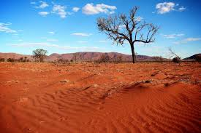

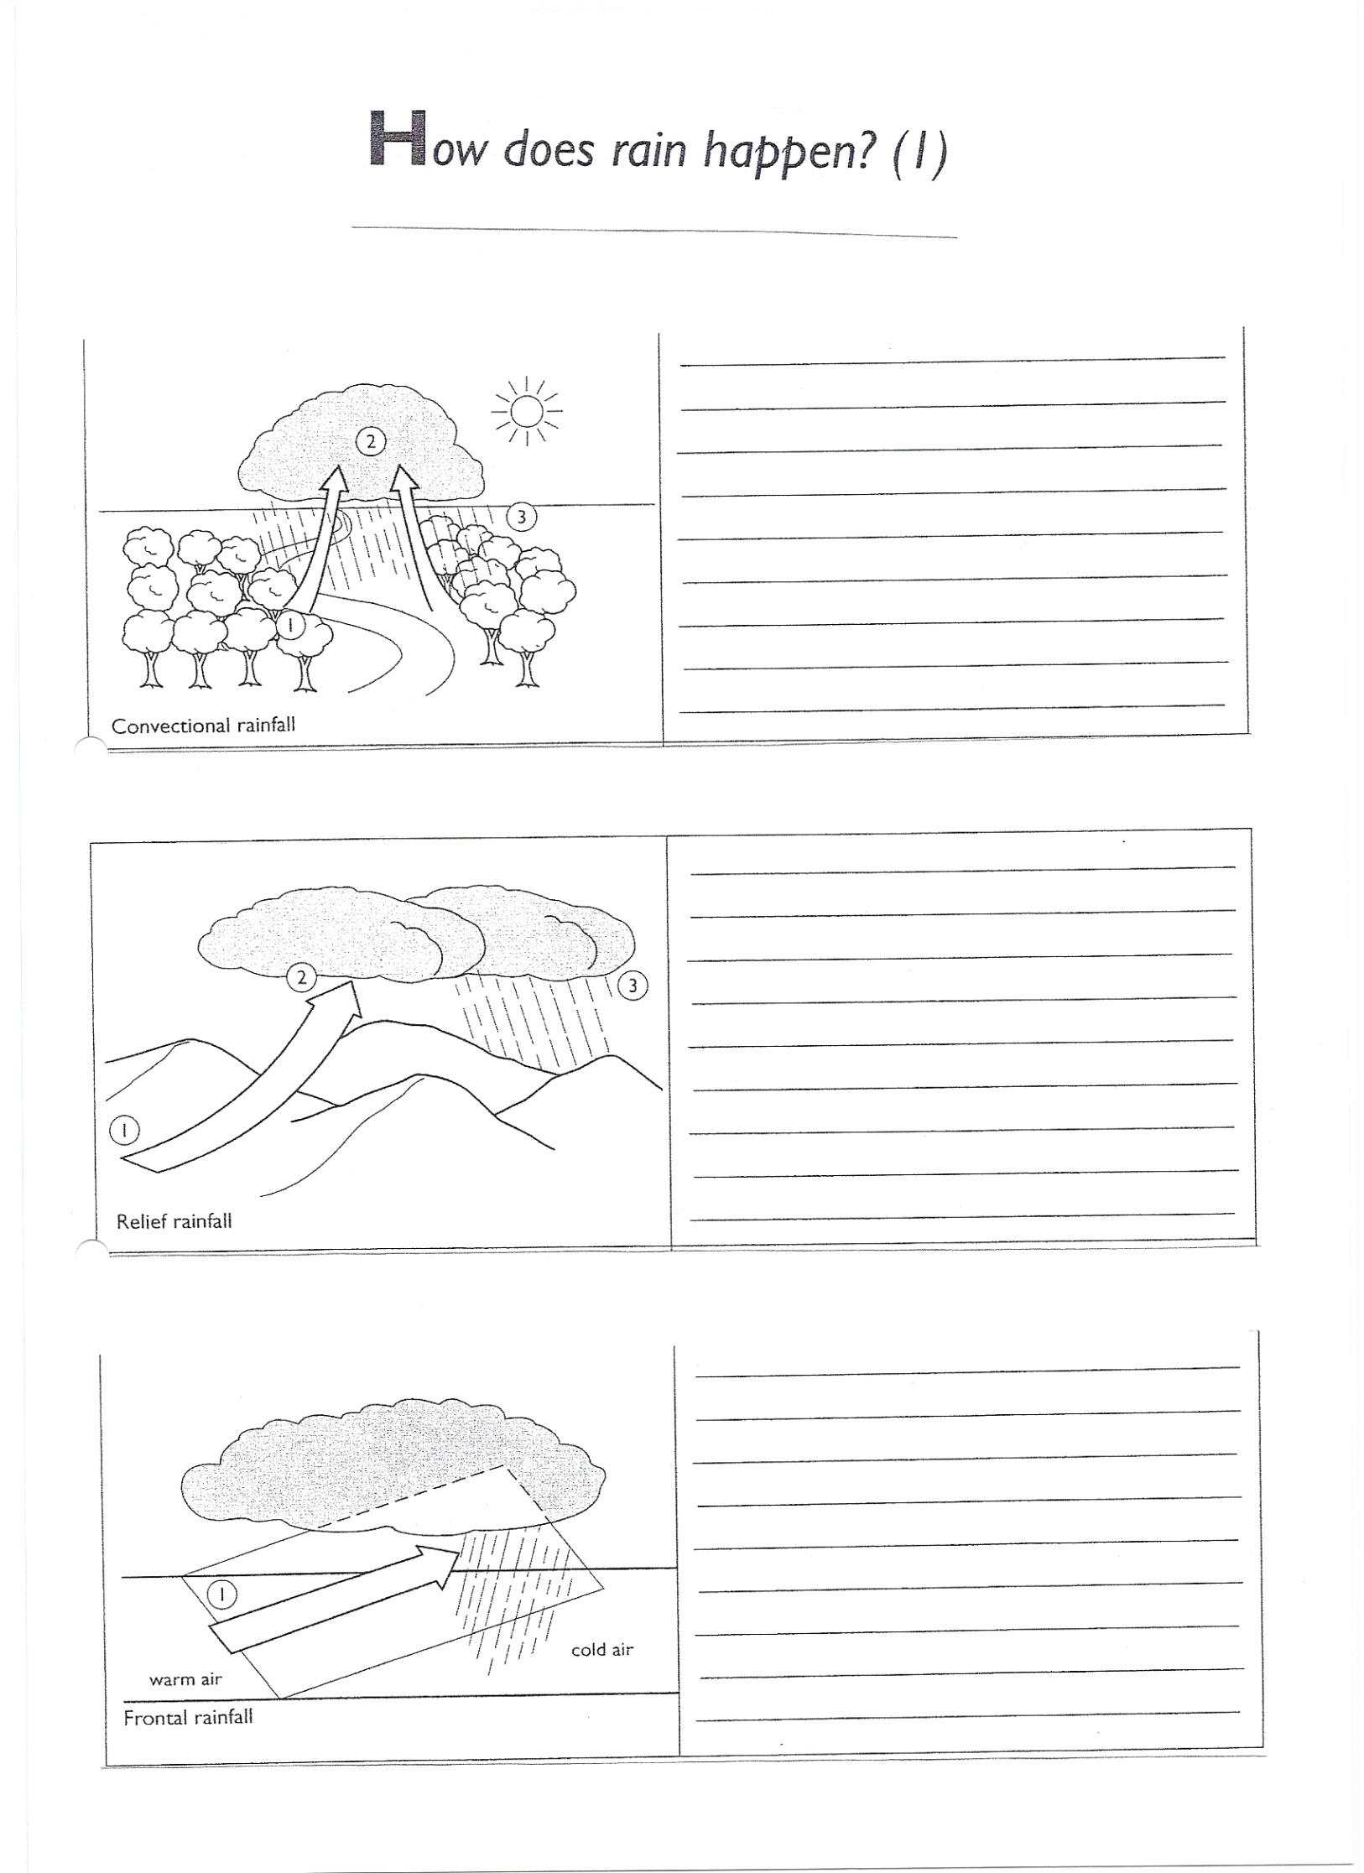
The Three Causes of Rain
Convectional
1 - The sun is the driving force behind the process of convection which is the main process behind the creation of rain.
2 - The sun heats up the ground and this in turn heats up the air. The sun cannot directly heat the air. When the water is heated, it turns to water vapour – a gas!
3 - As the air is warm, it rises up into the atmosphere, taking the water vapour with it. As it does so, it cools as it gets further away from its heat source (the sea).
4 - Eventually, the air and vapour cool to the point where the vapour (gas) condenses, making it visible as clouds.
5 - Water droplets within the clouds collide and join together to form rain drops, which fall back down to the sea / ground.

Slide 9
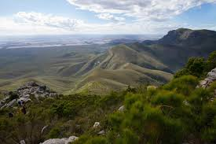

The Three Causes of Rain
Relief / Orographic Rain
1 - Air is forced to rise over a hill or mountain. As air rises away from the heat source (the ground heated up by the sun) the air cools by 1°C per 100m.
2 - As the water vapour in the air condenses, it forms clouds and rains. Air that has cooled cannot hold as much water as warmer air.
3 - The air starts to descend the hill or mountain and begins to warm up again.
4 - As air warms up, it can hold more water and as it has precipitated, the air has less water overall. Therefore clouds disappear and rain stops. This side of the relief feature is known as a RAINSHADOW.
Notes:
Write detailed notes on each process here:

Slide 10
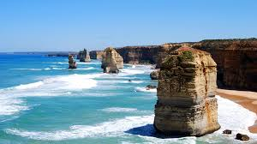
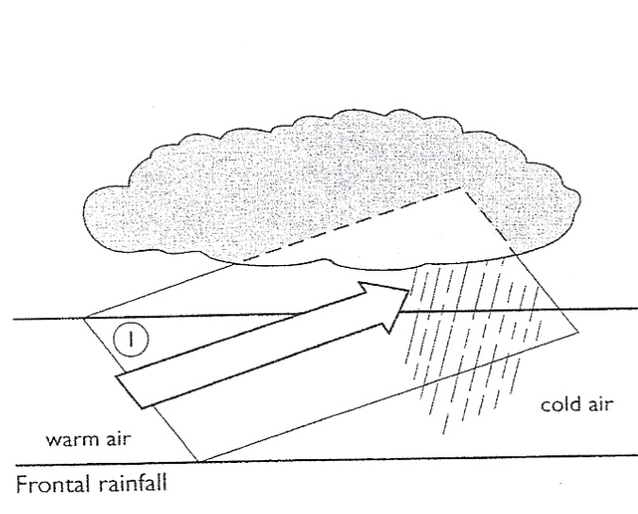
The Three Causes of Rain
Frontal / Cyclonic Rain
1 - The colder air mass is more dense than the warmer air mass, so carries on pushing forward along the ground.
2 - The warmer air mass is lighter than the colder one so is forced to rise over the advancing cold air mass.
3 - As the air is forced to rise, it cools and water vapour in the air condenses to form clouds.
4 - Further forcing of the air (now with clouds) upwards causes precipitation to occur.

Slide 11
Your Task
Watch the video which will help give another explanation of the 3 types of rain.
Once it has finished try to complete the work sheet to help you remember how each type of rain occurs.
Ext: If you finish the worksheet try to write an explanation under each one to suggest how this type of rainfall might influence different parts of Australia.

